Slide 1
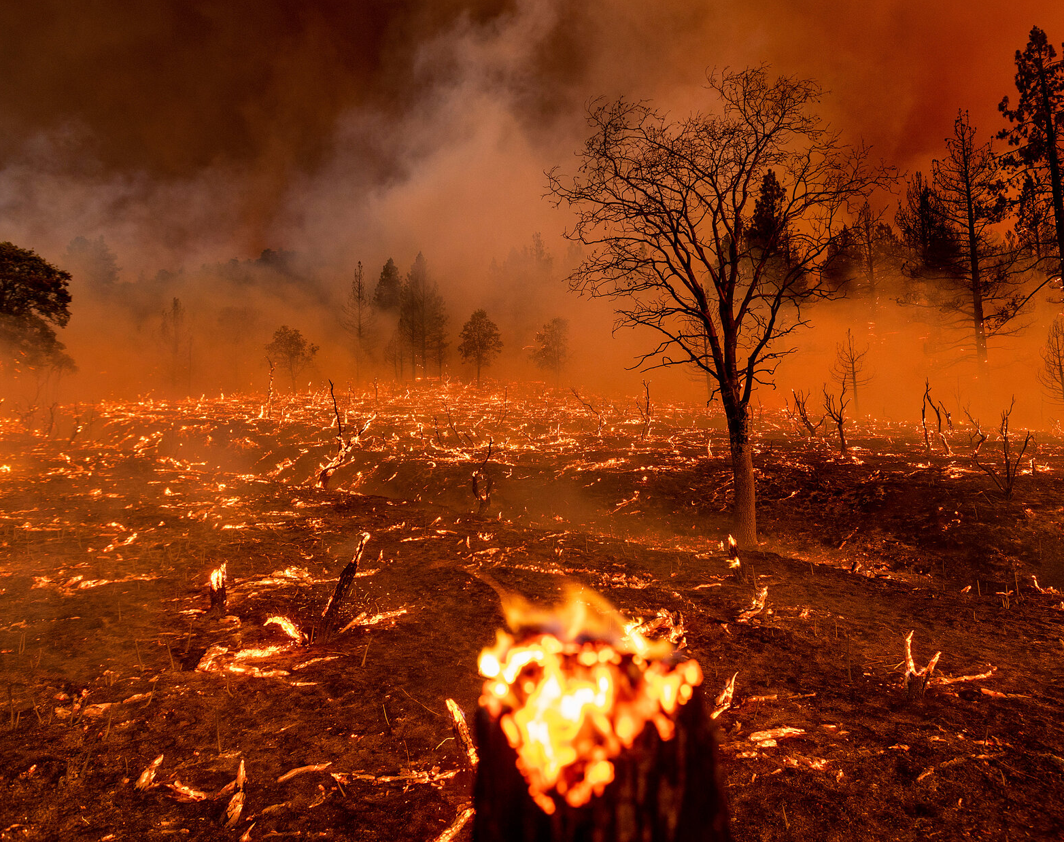
Wildfires in Rockies
Taylor, Ryan, Cole, Hunter, Talon

Slide 2
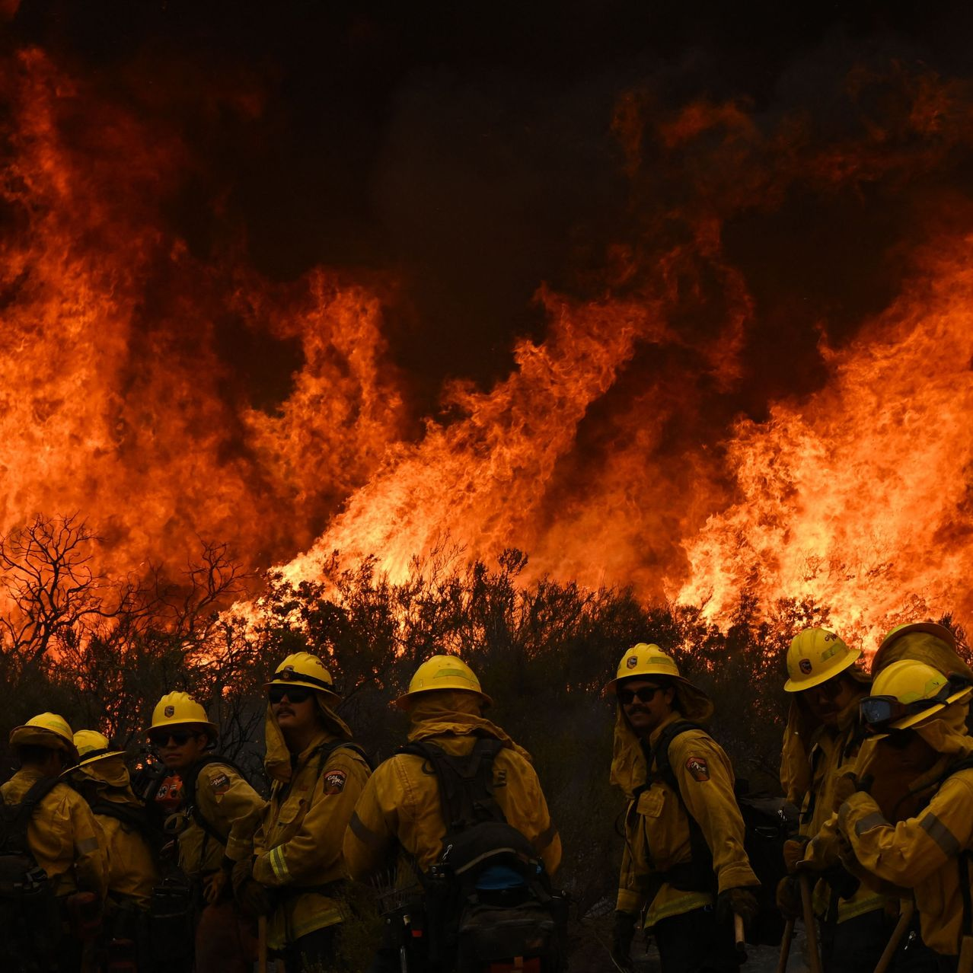
Collecting Data
Kaggle Data Set
Filter Data by States
Filter Data by Fire Size
Collect Data on Latitude and Longitude, Discovery Days and Times, Causes of the Fire, and Description of the Fire Cause

Slide 3
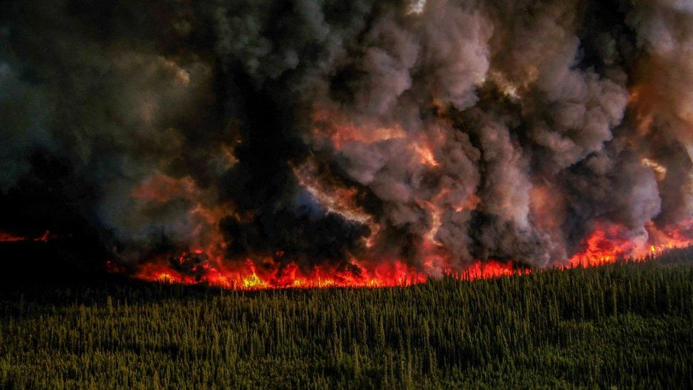
Data Backend
Data cleaned, organized and sorted with SQLite in a Jupyter Notebook
Minor Challenges
Overall had success in this initial phase

Slide 4
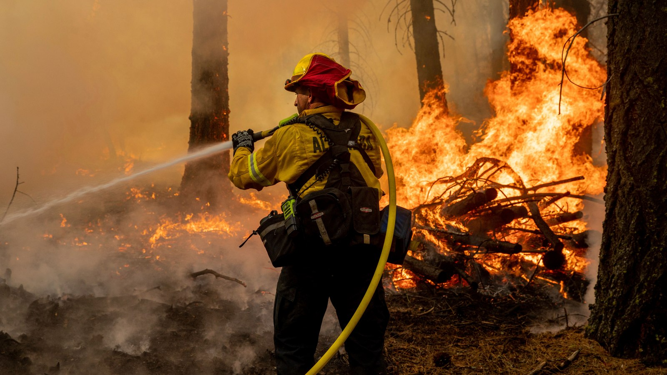
Front End Development
Used JavaScript with HTML/CSS and Leaflet
Found Map creation to be the easiest part
Struggled with most other functions and marker development

Slide 5
Final Product

Slide 6
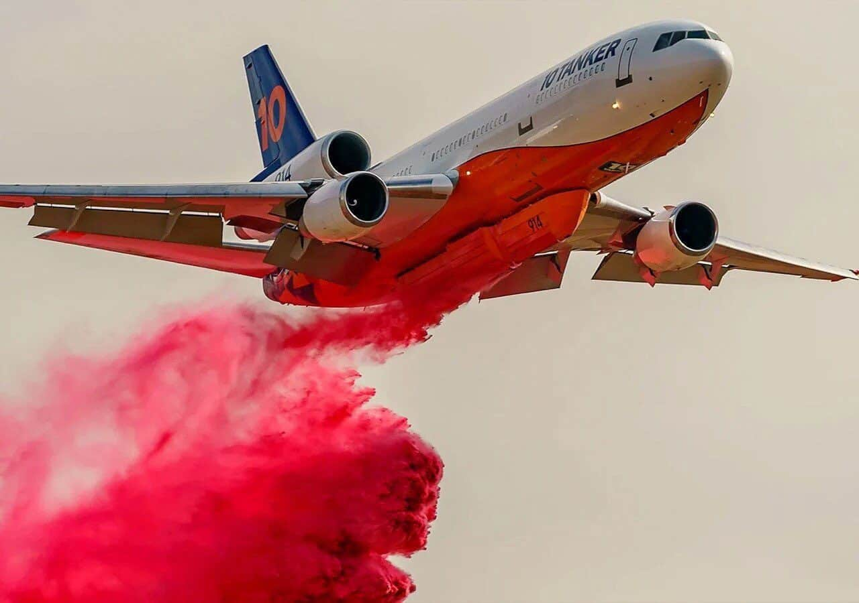
Interesting Findings
Number of Human caused Fires were almost equal to the amount of natural caused
Montana had the most fires followed by Colorado and then Wyoming
Misuse of fire by a minor made up almost as many causes of a fire as Smoking did
Minors caused nearly 2000+ fires in this time

Slide 7
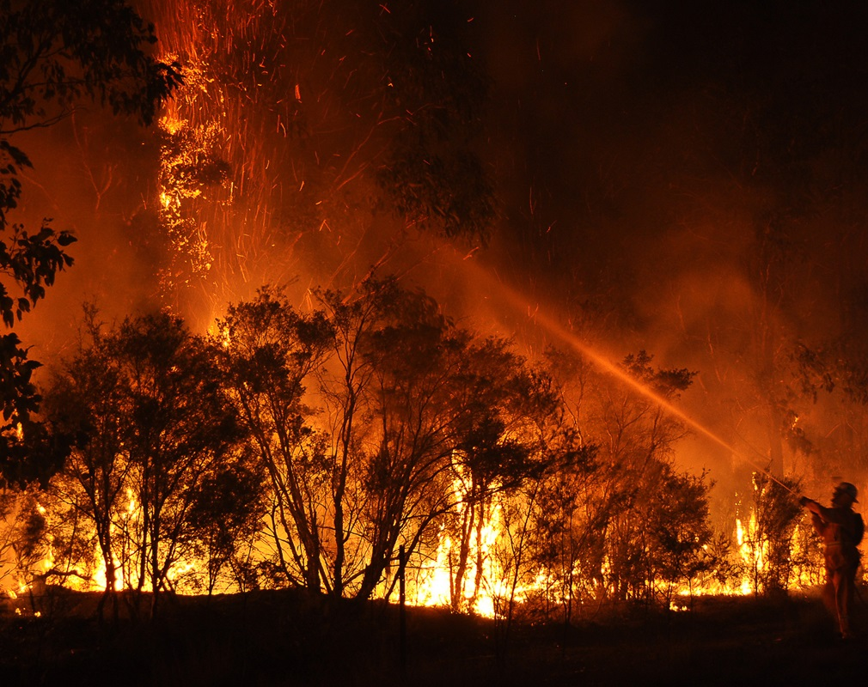
Thanks!

